Slide 1

Model Design and Building
Merit Badge
Troop 344 and 9344
Pemberville, OH

Slide 2
Model Design and Building
Merit Badge Requirements
Study and understand the requirements for personal safety when using such model maker hand tools such as: knives, handsaws, vices, files, hammers, screwdrivers, hand drills and drill bits, pliers, and portable power tools, and when to use protective equipment such as goggles when grinding or drilling. Know what precautions to take when using flammable or hazardous products such as: glue, epoxy, paint, thinners. Discuss these with your counselor before you begin your model-making project and tell why they are important.
Explain the uses for each of the following types of models: architectural, structural, process, mechanical, and industrial. Do research into the different types of materials that could be used in making these models.
With your counselor's advice, select a subject from requirement 4 for your model project. Kits may not be used. Prepare the necessary plans to the proper scale. This model should be your own original work. Tell your counselor why you selected this project.

Slide 3
Model Design and Building
Merit Badge Requirements
Do ONE of the following:
  Make an architectural model. Build a model of a house to a scale of 1/4" = 1'0" (1:50 scale). After completing the model, present it to your counselor for approval. Review with your counselor the materials you used and the details of your model.
  Build a structural model. Construct a model showing corner construction of a wood-frame building to a scale of 1 1/2" = 1'0" (1:8 scale). All structures shown must be to scale. Cardboard or flat sheet wood stock may be used for sheeting or flooring on the model. Review with your counselor the problems you encountered in gathering the materials and supporting the structure. Be able to name the parts of the floor and wall frames, such as intermediate girder, joist, bridging, subfloor, sill, sole plate, stud, and rafter.

Slide 4
Model Design and Building
Merit Badge Requirements
Do ONE of the following:
  Make a process model. Build a model showing the plumbing system in your house. Show hot and cold water supply, all waste returns, and venting to a scale of 3/4" = 1'0" (1:15 scale). After completion, present the model to your counselor. Discuss the scale, the materials used, and any problems you encountered in building the model.
  Complete a mechanical model. Build a model of a mechanical device that uses at least two of the six simple machines. After completing the model, present it to your counselor. Be prepared to discuss materials used, the machine's function, and any particular difficulty you may have encountered.
  Make an industrial model. Build a model of an actual passenger-carrying vehicle to a scale of 1" = 1'0" or 1/2" = 1'0" (1:10 or 1:25 scale). Take the dimensions of the vehicle and record the important dimensions. Draw the top, front, rear, and sides of the vehicle to scale. From your plans, build a model of the vehicle. Discuss with your counselor the most difficult part of completing the model.

Slide 5
Model Design and Building
Merit Badge Requirements
Build a special-effects model of a fantasy spacecraft or a hand-held prop that might appear in a Hollywood science-fiction movie. Determine an appropriate scale for your design. Include a cockpit or control area, living space, storage unit, engineering spaces, and propulsion systems. As you plan and build your model, do the following:
  Study existing designs of vehicles and hand-held devices.
  Arrange and assemble the parts.
  Sketch your completed model.
  Discuss your design, scale, and materials choices with your counselor. Describe how you engineered your model and discuss any difficulties you encountered and what you learned.
List at least six occupations in which model making is used and discuss with your counselor some career opportunities in this field.

Slide 6
Requirement 1
Study and understand the requirements for personal safety when using such model maker hand tools such as: knives, handsaws, vises, files, hammers, screwdrivers, hand drills and drill bits, pliers, and portable power tools, and when to use protective equipment such as goggles when grinding or drilling. Know what precautions to take when using flammable or hazardous products such as: glue, epoxy, paint, thinners. Discuss these with your counselor before you begin your model-making project and tell why they are important.

Slide 7
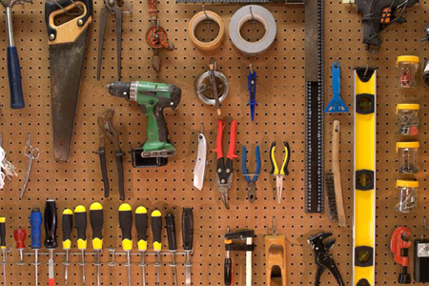
1. Do’s and Don’ts of Using Tools
Never work alone when using power tools.
Use each tool for what it was made to do – never for anything else. For example, use a screwdriver only for driving screws, not as a chisel or a pry bar.
Inspect your tools and use only tools that are in good working condition. Broken tools could hurt you or damage your model.
Get out only the tools you need and return them to your toolbox as soon as you are finished. This will keep your work area neat and prevent damage to the tools.
Take good care of your tools. Keep them clean, oiled, and sharp.

Slide 8
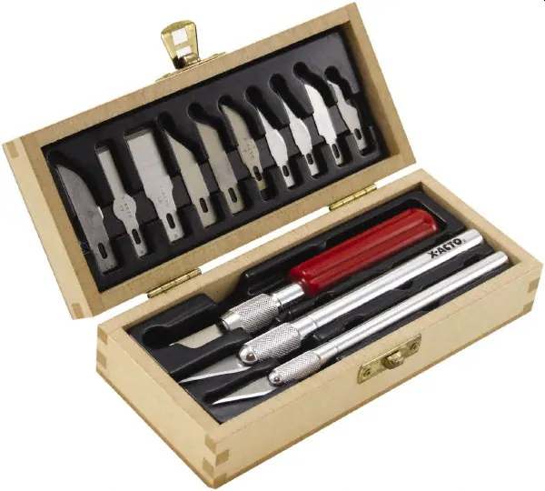
1. Tool Safety
Knives
  Use sharp blades that do not have any nicks.
  Cut away from your body.
  When you are done, cover the blade and put the knife away.

Slide 9
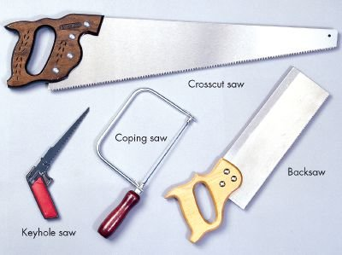
1. Tool Safety
Handsaws
  Use a vise to secure the material being sawed.
  To prevent buckling or breaking, adjust the blade tension and make sure blades are installed firmly in the correct position.
  While working, provide enough clearance so that, as you saw, the point of the saw will not strike any object.
  Use steady, even strokes without bending the blade.
  When finished sawing, carefully wipe the blade clean and store the saw safely in a tool rack.

Slide 10
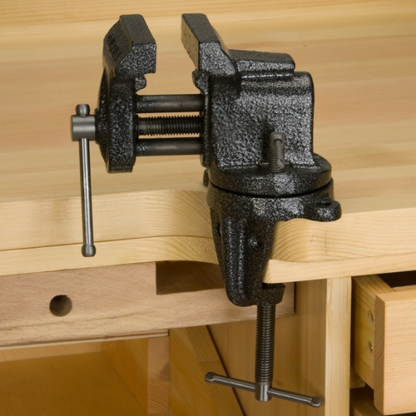
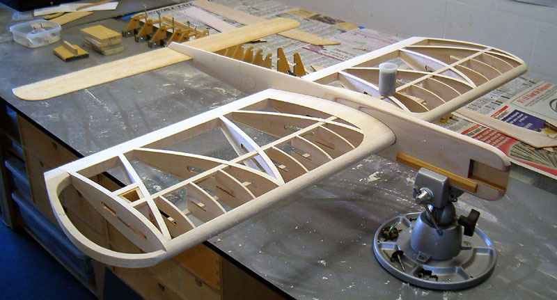
1. Tool Safety
Vises
  Always attach the vise to a firm work stand and use the vise – never your hands – to secure materials.
  Use just enough pressure to securely hold materials.
  Stay clear of the vise body during drilling or cutting operations.
  When you are done, close the vise and leave the handle straight up and down.

Slide 11
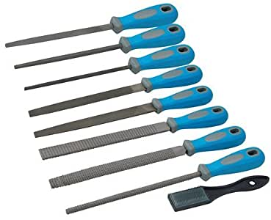
1. Tool Safety
Files
  Always use a file with a handle.
  Cut in the direction for which the file was intended.
  Keep hard objects from striking the file teeth or handle.
  After use, clean a file with a wire brush.
  Store files in a single layer (never on top of each other) in a dry place.

Slide 12
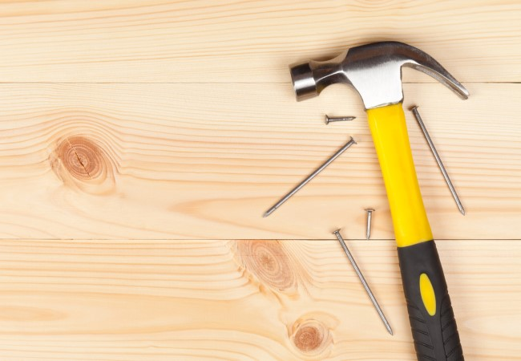
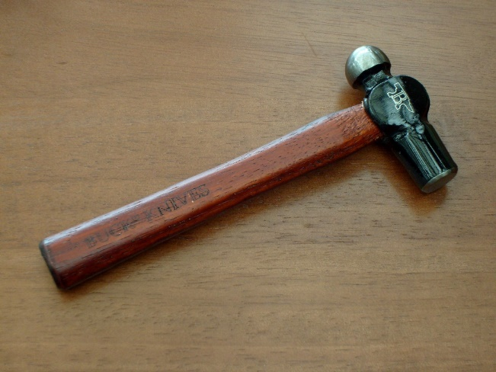
1. Tool Safety
Hammers
  Always use the face of the hammer when striking an object, and use only the amount of force needed.
  Use claw hammers for wood and ball peen hammers for metal.
  Only use a hammer’s claw for removing nails.

Slide 13
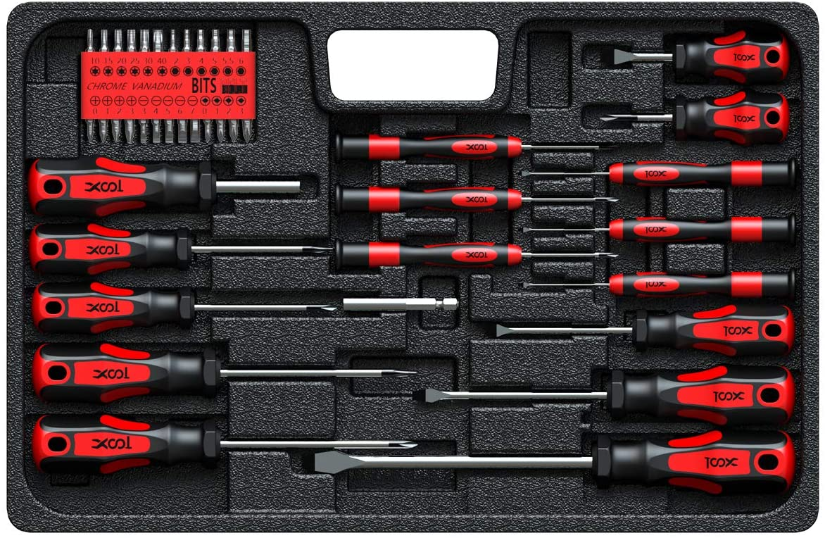
1. Tool Safety
Screwdrivers
  Choose the correct blade size when using a screwdriver.
  Keep the handle directly over the screw head and turn with smooth, even strokes while applying steady pressure on the screw.

Slide 14

1. Tool Safety
Hand drills and drill bits
  Use a vise or clamp to secure the material being drilled.
  Do not force a drill into the work.
  Run the drill at the correct speed for the material.
  Keep the bit away from any clamping device.
  As you work, use a brush to sweep away chips.
  Always use sharp bits and drill only materials for which the bits were designed for.
  Tighten the shank of the drill bit securely in the chuck; never use pliers to tighten a bit

Slide 15
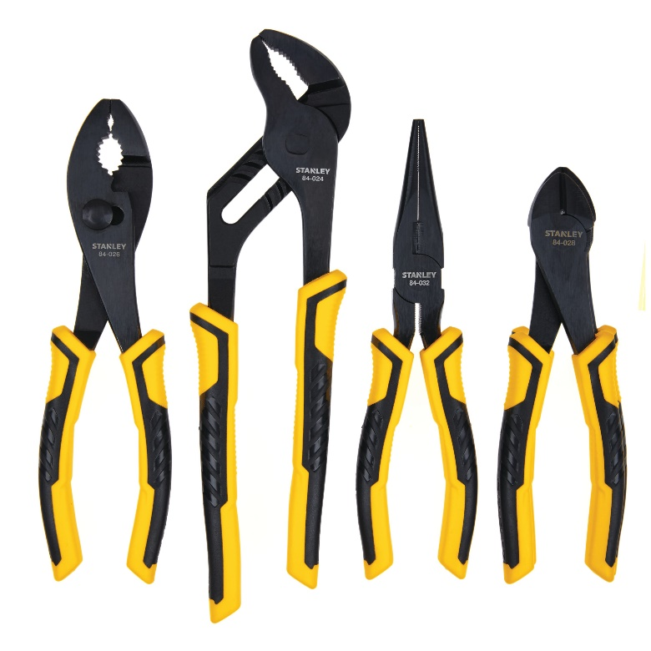
1. Tool Safety
Pliers
  Be sure your fingers or hands do not get pinched between the handles of pliers.
  When using cutting pliers, cover the piece you are cutting or point it away from you and other people. The cut piece may become airborne.

Slide 16
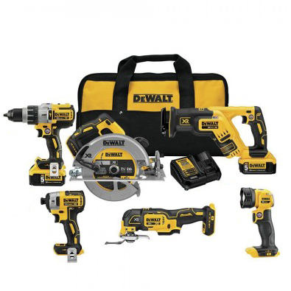
1. Tool Safety
Portable power tools
  Use portable tools only for the work they are meant to do.
  When using a corded power tool, arrange the cord so that it will not be in the way of the operation.
  Carry a portable power tool by its handle, not its cord.
  When unplugging a power tool, grasp the plug head, not the cord, and pull straight out from the wall socket or extension cord.

Slide 17
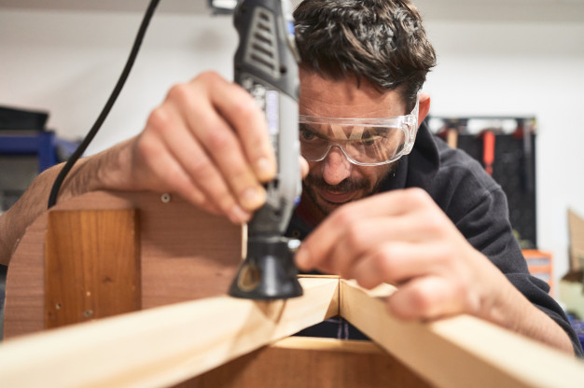
1. Safety Equipment
Safety Glasses
  Using the proper equipment will prevent most accidents, but be prepared for the unexpected.
  Whenever appropriate, wear goggles or safety glasses.
  Be sure to clean the goggles or safety glasses after use.

Slide 18
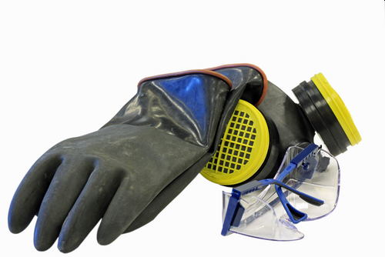
1. Flammable or Hazardous Product Safety
When using glue, epoxy, paint, or thinners, be sure to read and follow the manufacturer’s instructions.
Work in a well-ventilated area so that you won’t breathe in the fumes, which can be harmful.
Use a respirator as needed.
Avoid skin exposure when handling these products.
Use protective nonlatex gloves as needed.

Slide 19
Requirement 2
Explain the uses for each of the following types of models: architectural, structural, process, mechanical, and industrial. Do research into the different types of materials that could be used in making these models.

Slide 20
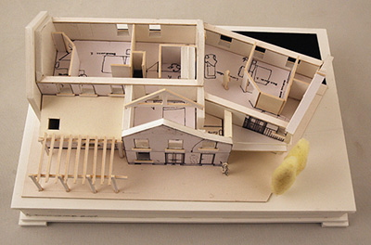
2. Architectural Model
An architectural model is a 3D representation of a proposed building design.
With an architecture model, you can see the potential scale and design of a construction or interior design project.
Traditionally, model makers manually created these replicas, but thanks to advancements in computer technology, 3D models are now widely used to represent a construction idea.

Slide 21
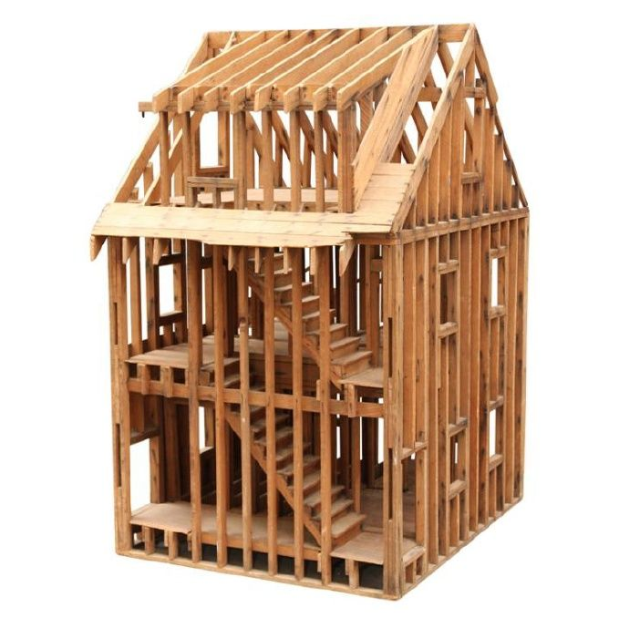
2. Structural Model
A structural model shows the details of construction.
The individual pieces that make up the floor, wall, and roof structures are reproduced in miniature.

Slide 22
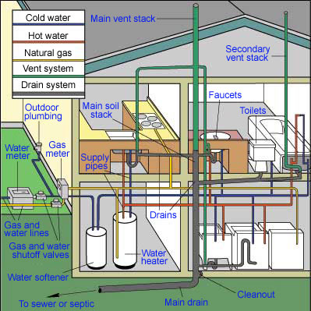
2. Process Model
Where Architectural Models show how buildings look and Structural Models show how buildings are constructed, Process Models show how buildings work.
Engineers build process models to show on a small scale what a building such a manufacturing plant will look like and operate once it is constructed.
The models demonstrate in three dimensions the placement of equipment, pipes, and other components.
Viewers can easily understand process models because the look just like the real thing, only smaller.

Slide 23
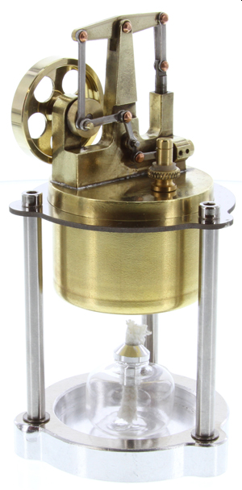
2. Mechanical Model
Used to help visualize the design of complex machinery, cams, gears, levers, and other moving parts
Model of Steam Engine

Slide 24
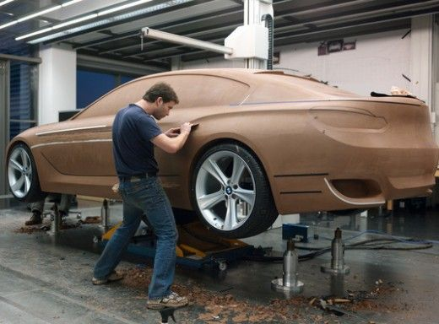
2. Industrial Model
Used to design products of all varieties before they are manufactured – toys, cars, aircraft, furniture, etc.
Helps to visualize what the final product will look like and often used to promote products to potential customers
Clay Model of a Car

Slide 25
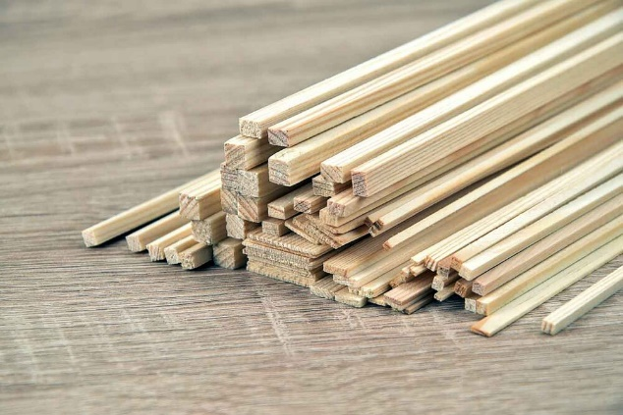
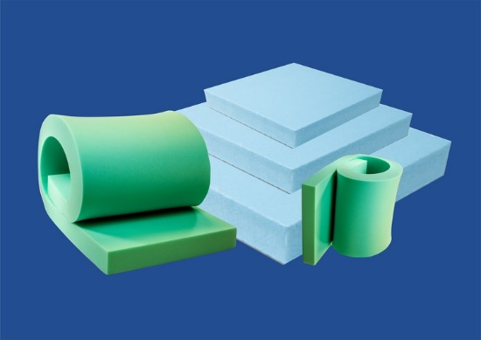
2. Materials for Model Making
Rough study models can be made quickly using cardboard, wooden blocks, polystyrene, foam, foam boards and other materials. Such models are an efficient design tool for three-dimensional understanding of a structure, space or form, used by architects, interior designers and exhibit designers.
Common materials used for centuries in architectural model building were card stock, balsa wood, basswood and other woods. Modern professional architectural model builders are taking advantage of twenty-first century materials, such as Taskboard (a flexible and lightweight wood/fiber board), plastics, wooden and wooden-plastic composites, foams, foam board and urethane compounds.

Slide 26
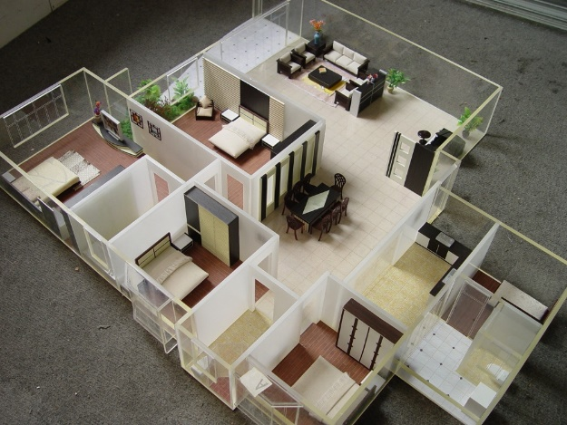
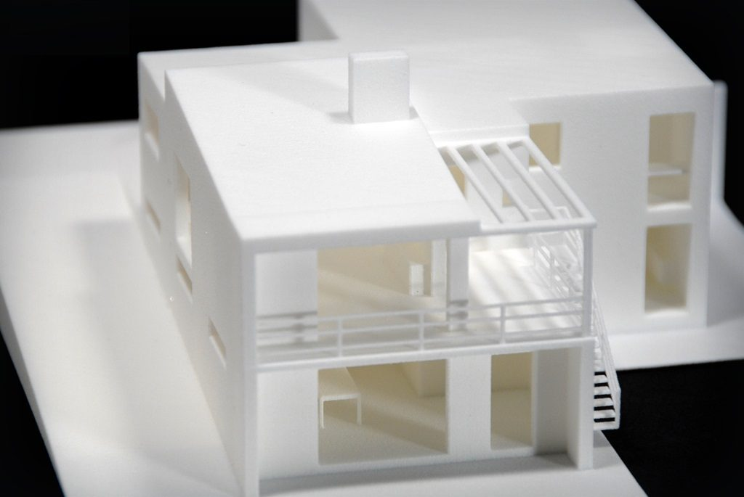
2. Materials for Model Making
A number of companies produce ready-made pieces for structural components (e.g. girders, beams), siding, furniture, figures (people), vehicles, trees, bushes and other features which are found in the models. Features such as vehicles, people figurines, trees, street lights and other are called "scenery elements" and serve not only to beautify the model, but also to help the observer to obtain a correct feel of scale and proportions represented by the model.
Increasingly, rapid prototyping techniques such as 3D printing and CNC routing are used to automatically construct models straight from CAD plans.

Slide 27
Requirement 3
With your counselor's advice, select a subject from requirement 4 for your model project. Kits may not be used. Prepare the necessary plans to the proper scale. This model should be your own original work. Tell your counselor why you selected this project.

Slide 28
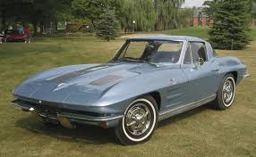
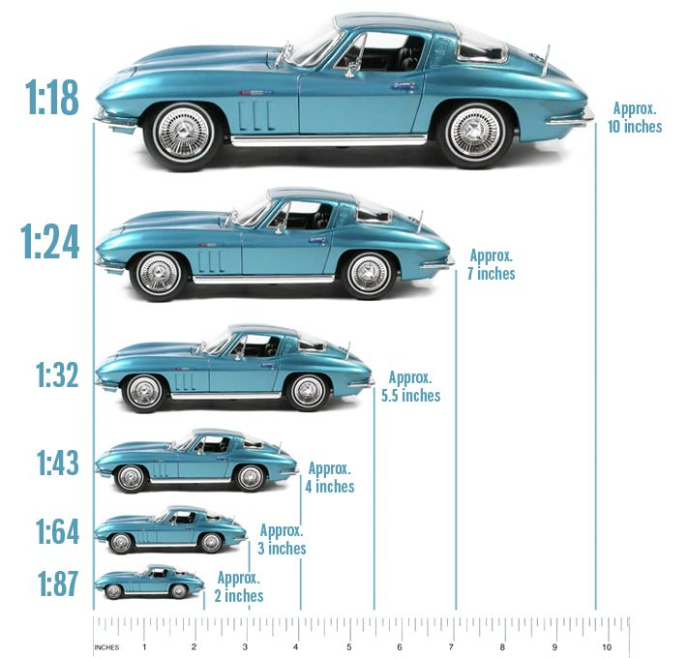
3. Scale
175.3”
How to Choose the Best Model Size for You
  Models come in a range of scales, the most common being 1:4, 1:8, 1:12, 1:16, 1:18, 1:24, 1:48, and 1:72. Choosing a scale that works for you is the first big step in mastering your model builds.
Why is Scale So Important?
  Scale determines not only the size of your model, but also influences the amount of materials you will need for making your model.
  Some of your materials may be limited in dimension, so you may need to pick a scale that will work out for more optimal material usage.
  Examples: Wood may only be available in ¼”, ½”, or ¾” thicknesses; cardboard may only be 24” wide.

Slide 29

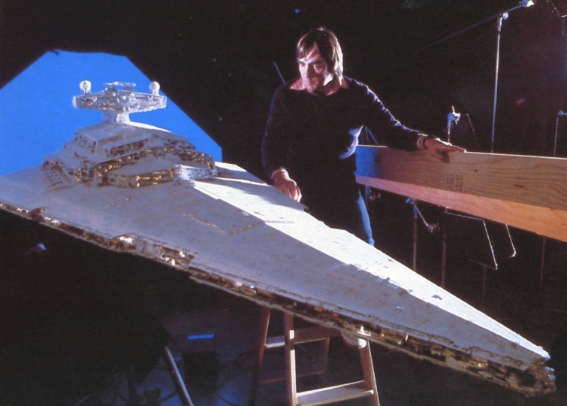
3. Scale
Scale determines the size of the model vs. reality
  Expressed as “model unit” = “reality unit”.
  The model can be bigger than OR smaller than reality.
    Model of an atom – bigger than reality.
    Model of a real Star Destroyer – smaller than reality.
  Keep the same scale for all dimensions – width, height, length.
  Pick an easy scale to work with. For example, 1 inch = 1 foot is easier than 1.35 inches = 1 foot.

Slide 30
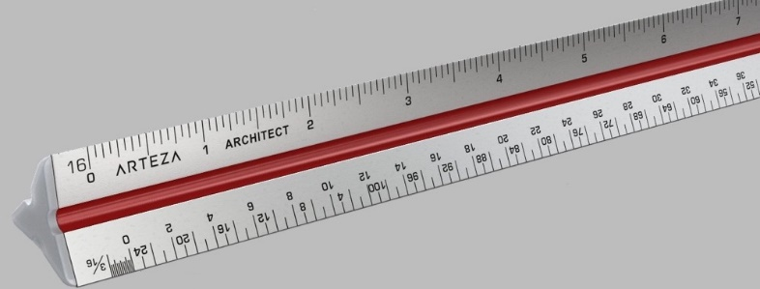
3. Architectural Scale Ruler
The Architect’s Scale Ruler for drawing by hand takes care of all the math.
It is designed for use in determining actual dimensions of distance on scaled drawing.

Slide 31
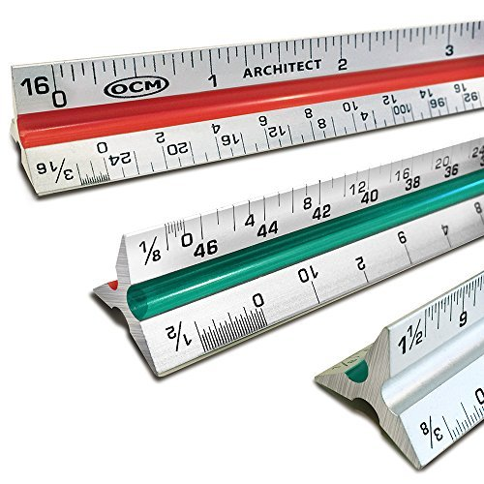
3. Architectural Scale Ruler
There are two scales on each edge.
One scale reads left to right while the other reads right to left.
  Must know scale of drawing or item that is being measured.
  Once scale of drawing has been determined, select correct scale on the ruler. For example, 1/8 on ruler is a scale that converts 1/8 inch on drawing to 1 foot.

Slide 32
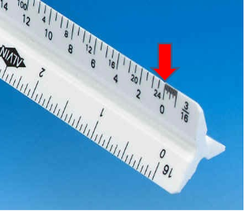
3. Architectural Scale Ruler
Line up zero mark on scale selected with beginning of item being measured
Determine at what point on scale the end of the item you wish to measure is.
Read number off the scale that is closest to the ending point of the item measured.
Mentally note this number and be sure to 'round down‘ even if you are close to the next number.
This number represents the whole feet of the item you are measuring.

Slide 33

3. Architectural Scale Ruler
Slide ruler so that the number you noted mentally lines up with the end of the item being measured.
Now go back to the zero end of the scale - fractional feet to be measured will be represented by distance of the start point of the object being measured to the zero point on the scale.
Take reading from this part of scale and add this number to the whole feet you mentally noted earlier.

Slide 34
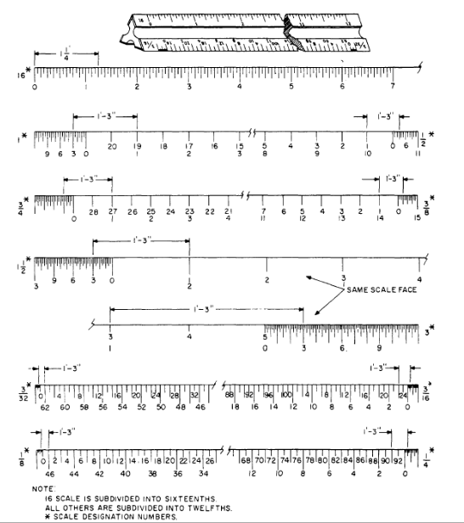
3. Architectural Scale Ruler
Each of these measurements on the architectural ruler is equal to 1’ 3” in real life.

Slide 35
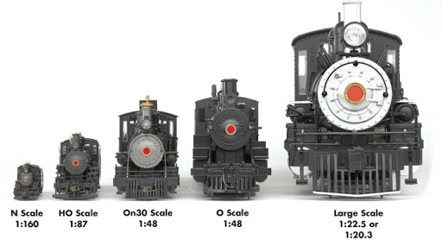
3. Scale
Model Design
Scale Conversions
Model dimension = Reality dimension x Scale
  where Scale = Model unit / Reality unit
Reality dimension = Model dimension x Scale
  where Scale = Reality unit / Model unit
The following shows how the units cancel out to get to the desired dimension:
  Model scale: 1 inch = 10 feet (If model is 1 inch long, the object in reality is 10 feet long)
    If model is 10 inches long, how long is the real thing?
    Length (reality) = 10 inch (model) x 10 feet (reality) = 100 feet
    1 inch (model)
  Model scale: 1/4 inch = 1 foot (If model is 1 inch tall, the object in reality is 4 feet tall)
    If model is 6 inches tall, how tall is the real thing?
    Height (reality) = 6 inch (model) x 4 feet (reality) = 24 feet
    1 inch (model)
  Model scale: 1/8 inch = 1 foot (If model is 1 inch wide, the object in reality is 8 feet wide)
    If the real thing is 40 feet wide, how wide is the model?
    Width (reality) = 40 feet (reality) x 1 inch (model) = 5 inches
    8 feet (reality)

Slide 36
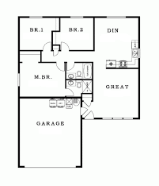
3. Scale
Assume that we would like to make an architectural model of the scale house plan shown. Complete the following practice questions on working with scales.
Question 1: Use a scale of 1/4" (model) = 1’ (real)
  What will the overall model dimensions be?
Question 2: Use a scale of 1/2" (model) = 1’ (real)
  What will the overall model dimensions be?
Question 3: Use a scale of 1" (model) = 1’ (real)
  What will the overall model dimensions be?
Question 4: Question 4: If the largest dimension of cardboard you can obtain is 24” and you make each outside wall from one piece of cardboard, what is the maximum practical scale you can use (1:1, 1:2, 1:4, 1:8, 1:12, 1:16, 1:18, 1:24, 1:48, or 1:72)?
Answers on next page.
40 feet
50 feet

Slide 37
3. Scale
Assume that we would like to make an architectural model of the scale house plan shown. Complete the following practice questions on working with scales.
Question 1: Use a scale of 1/4" (model) = 1’ (real)
  What will the overall model dimensions be?
  40’ x 1”/4’ = 10” 50’ x 1”/4’ = 12.5”
Question 2: Use a scale of 1/2" (model) = 1’ (real)
  What will the overall model dimensions be?
40’ x 1”/2’ = 20” 50’ x 1”/2’ = 25”
Question 3: Use a scale of 1" (model) = 1’ (real)
  What will the overall model dimensions be?
40’ x 1”/1’ = 40” 50’ x 1”/1’ = 50”
Question 4: If the largest dimension of cardboard you can obtain is 24” and you make each outside wall from one piece of cardboard, what is the maximum practical scale you can use (1:1, 1:2, 1:4, 1:8, 1:12, 1:16, 1:18, 1:24, 1:48, or 1:72)?
50’ is the longest wall. 50’ x 1”/1’ = 50”
50’ x 1”/2’ = 25”
50’ x 1”/4’ = 12.5”
40 feet
50 feet

Slide 38
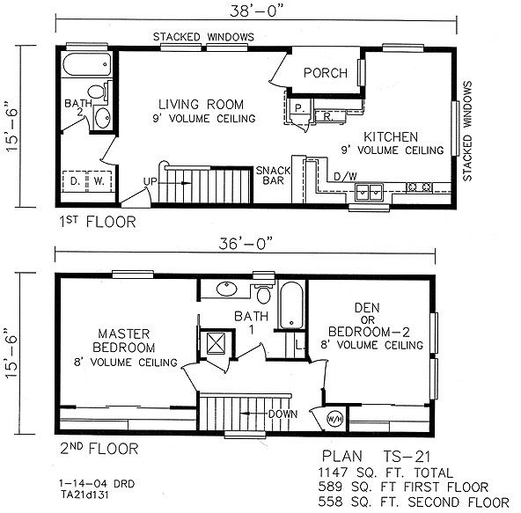
3. Planning for Your Model Project
Small Two Story Home Plan
Select a subject from requirement 4 for your model project. Kits may not be used. Prepare the necessary plans to the proper scale. This model should be your own original work. Tell your counselor why you selected this project.
Example: 4a. Build a model of a house to a scale of 1/4" = 1'0"
  Create a house floor plan and include the overall dimensions and the dimensions of each room.

Slide 39
Requirement 4
Do ONE of the following:
  Make an architectural model. Build a model of a house to a scale of 1/4" = 1'0" (1:50 scale). After completing the model, present it to your counselor for approval. Review with your counselor the materials you used and the details of your model.
  Build a structural model. Construct a model showing corner construction of a wood-frame building to a scale of 1 1/2" = 1'0" (1:8 scale). All structures shown must be to scale. Cardboard or flat sheet wood stock may be used for sheeting or flooring on the model. Review with your counselor the problems you encountered in gathering the materials and supporting the structure. Be able to name the parts of the floor and wall frames, such as intermediate girder, joist, bridging, subfloor, sill, sole plate, stud, and rafter.
  Make a process model. Build a model showing the plumbing system in your house. Show hot and cold water supply, all waste returns, and venting to a scale of 3/4" = 1'0" (1:15 scale). After completion, present the model to your counselor. Discuss the scale, the materials used, and any problems you encountered in building the model.
  Complete a mechanical model. Build a model of a mechanical device that uses at least two of the six simple machines. After completing the model, present it to your counselor. Be prepared to discuss materials used, the machine's function, and any particular difficulty you may have encountered.
  Make an industrial model. Build a model of an actual passenger-carrying vehicle to a scale of 1" = 1'0" or 1/2" = 1'0" (1:10 or 1:25 scale). Take the dimensions of the vehicle and record the important dimensions. Draw the top, front, rear, and sides of the vehicle to scale. From your plans, build a model of the vehicle. Discuss with your counselor the most difficult part of completing the model.

Slide 40
4. Make Your Model
Small Two Story Home Plan
Example: Architectural Model
  4 a. Build a model of a house to a scale of 1/4" = 1'0" using the house floor plans you created in requirement 3.
    Step 1 – Construct the base of the house first. This will allow you to see the width of the walls. Measure the base by placing a copy of the floor plan over your base material. Make sure it is to scale, then cut out the dimensions for the base.
    Step 2 – Measure and cut out the exterior walls. Draw and cut out the window and door openings. It is easier to cut out door and window openings at this stage, while the walls can be laid flat on a work surface. It is much harder to make neat openings after the walls are fastened together.
Note: If doing a two story house, the second story is constructed like the first story and then set on top of the first story.

Slide 41
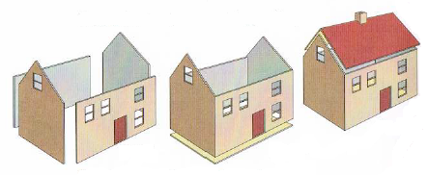
4. Make Your Model
Example: Architectural Model (continued)
    Step 3 – Apply glue to the edges and assemble the walls. Glue the walls to the base. If you plan to later add a porch, walkway, shrubbery, trees, or other outside features (be creative), extend the base far enough beyond the walls of the house to allow room for the additions.
    Step 4 – Make a peaked roof from one large piece of cardboard, scored and folded at the peak. To score cardboard, make a shallow groove by running a butter knife blade along the line where the fold is to be. Use a ruler as a guide so that the fold will be straight. Make the score on the inside of the fold (underside of the roof). Do not glue it down so that you can add interior walls. Cut the roof so that it hangs slightly over the ends and sides.
    Step 5 – Measure and cut out the interior walls. Draw and cut out any door or other openings. Apply glue to the edges and assemble the walls. Glue the walls to the exterior walls and base.

Slide 42
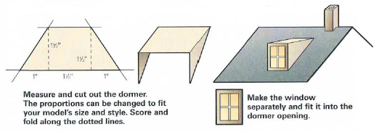
4. Make Your Model
To make a basic house model more realistic and attractive, add some architectural details.
Cut and fold cardboard to form a front porch and steps, or make them from blocks of wood.
Use thin strips of wood or cardboard to add shutters, window frames, and door frames.
Use clear plastic or transparent adhesive tape for windowpanes. Glue colored tissue paper or fabric behind windows for curtains.
Attach an extra room or shed simply by adding a box to the main structure.
To add a chimney, first fashion a small box. Then, cut an angled notch from the bottom of opposite sides of the box to fit the slope of the roof.
Add interest to a large, unbroken expanse of roof by attaching dormer windows as shown in the drawings.

Slide 43
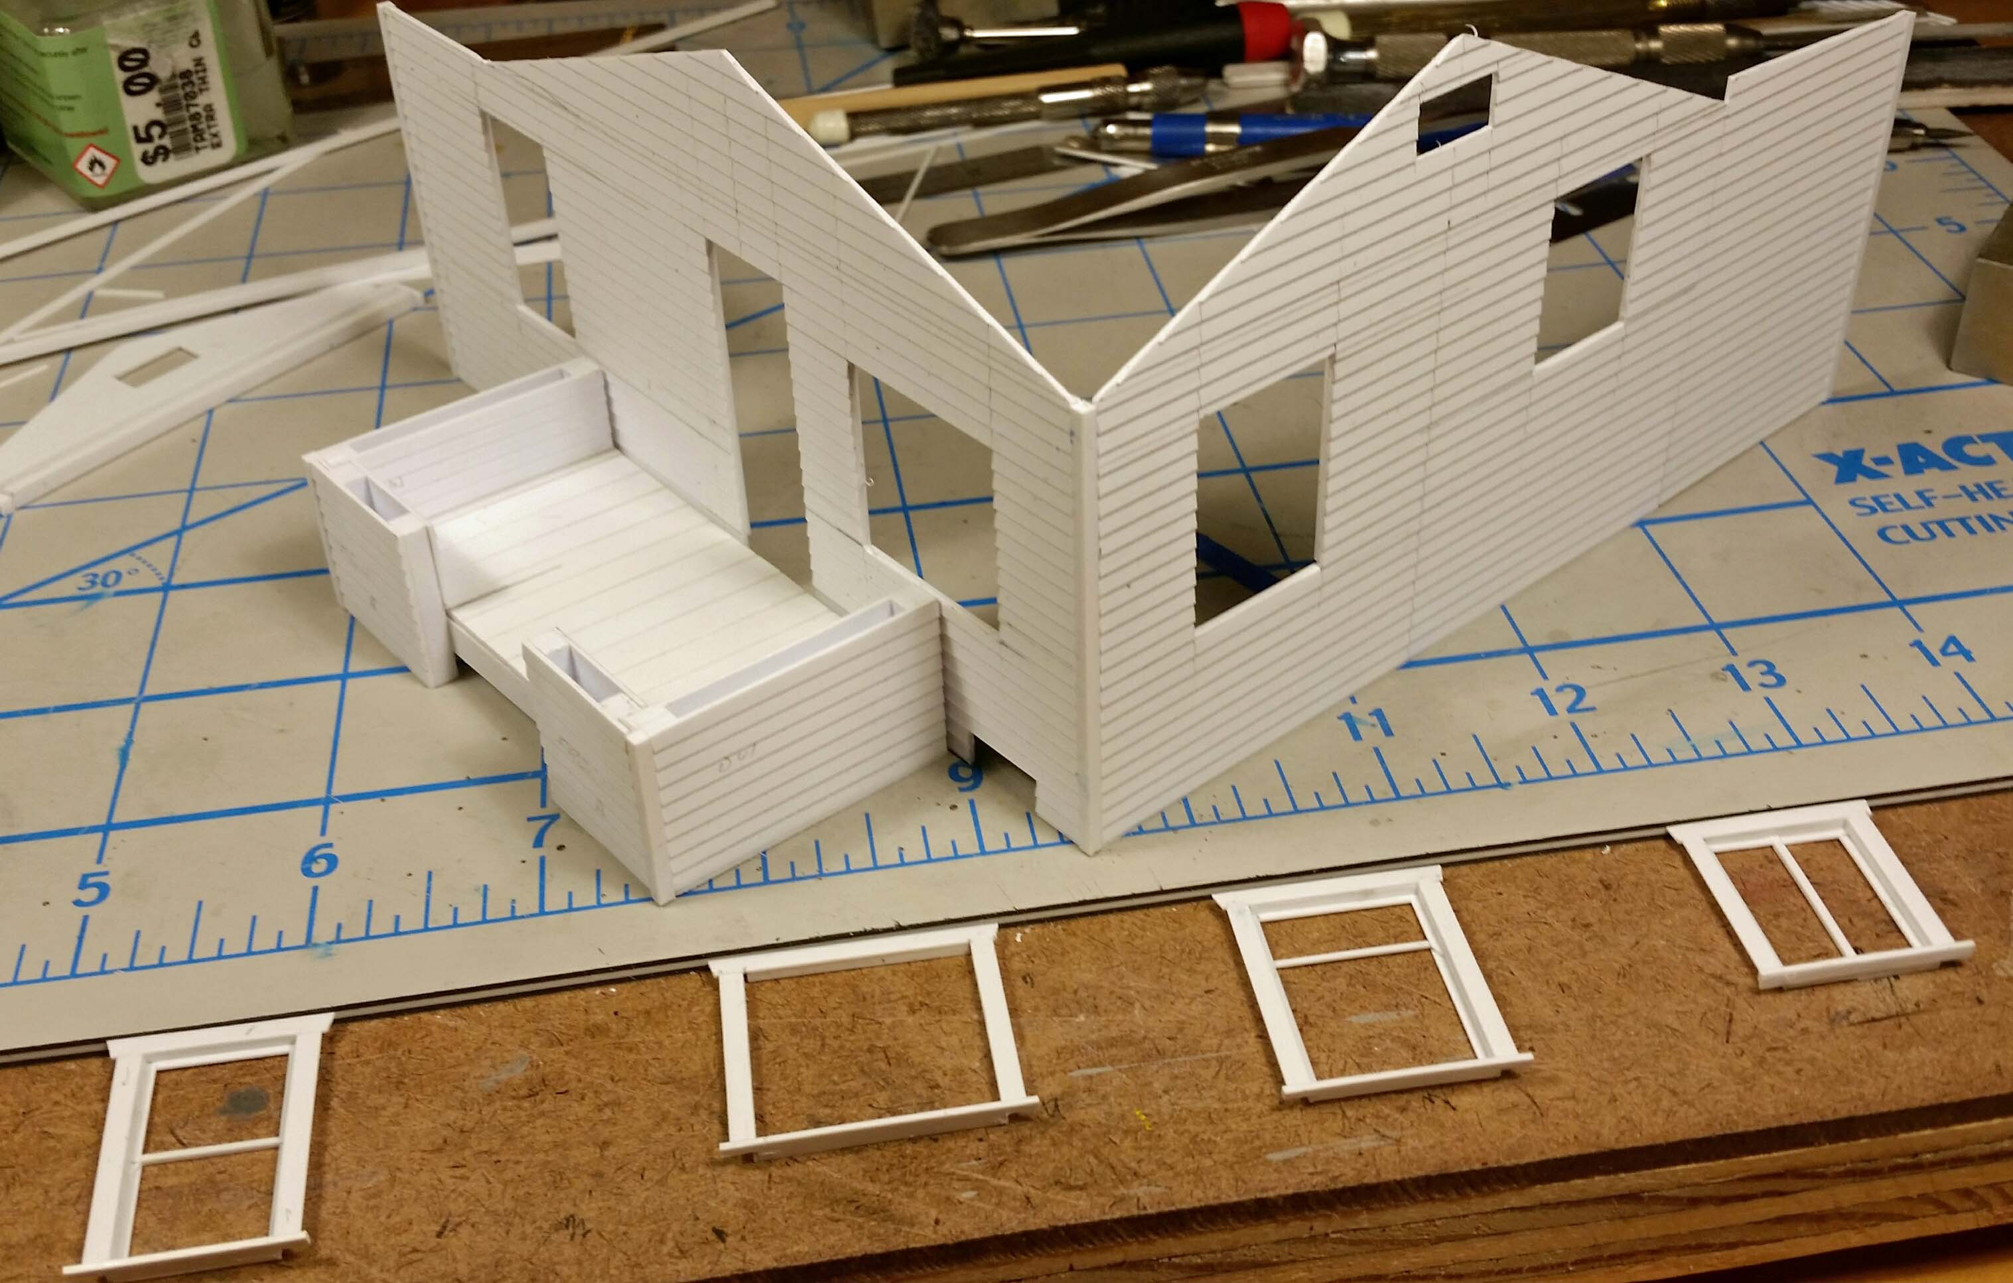
4. Make Your Model

Slide 44
Requirement 5
Build a special-effects model of a fantasy spacecraft or a hand-held prop that might appear in a Hollywood science-fiction movie. Determine an appropriate scale for your design. Include a cockpit or control area, living space, storage unit, engineering spaces, and propulsion systems. As you plan and build your model, do the following:
  Study existing designs of vehicles and hand-held devices.
  Arrange and assemble the parts.
  Sketch your completed model.
  Discuss your design, scale, and materials choices with your counselor. Describe how you engineered your model and discuss any difficulties you encountered and what you learned.

Slide 45
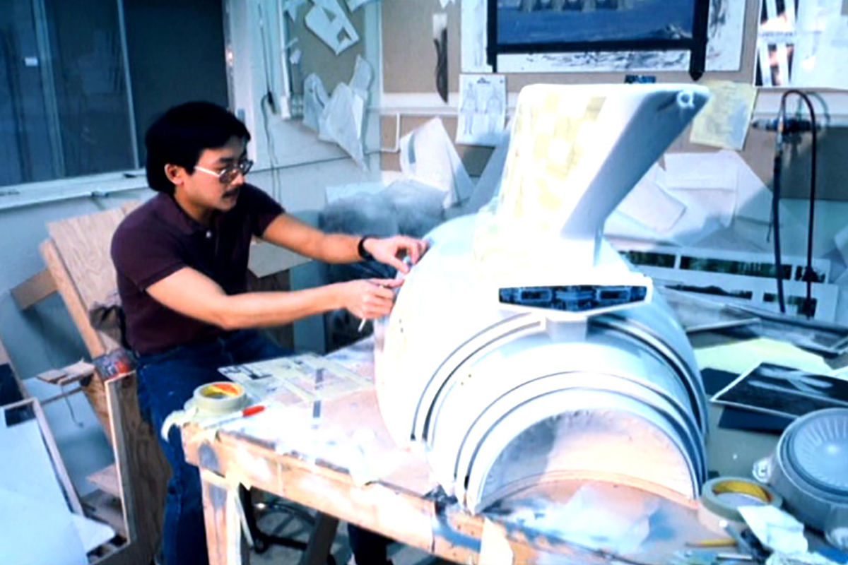
5. Steps for Making Your Special Effects Model
Find a good reference picture of what you want to model.
Determine an appropriate scale for your design and draw it.
Figure out all the parts and how they will go together.
Make outlines of each part and cut them out.
Assemble the parts to create the model.

Slide 46
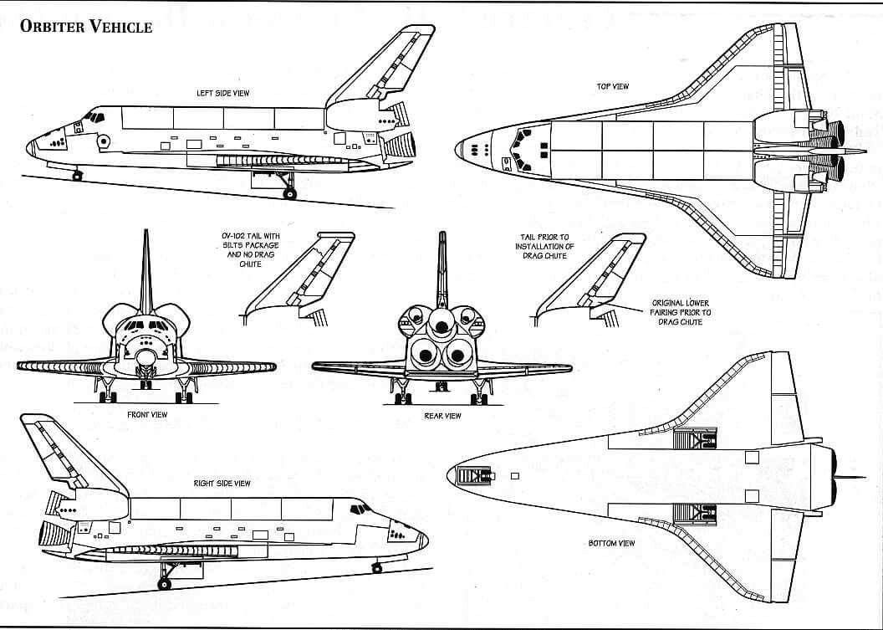
5. Steps for Making Your Special Effects Model
Step 1: Find a good reference picture of what you want to model.

Slide 47
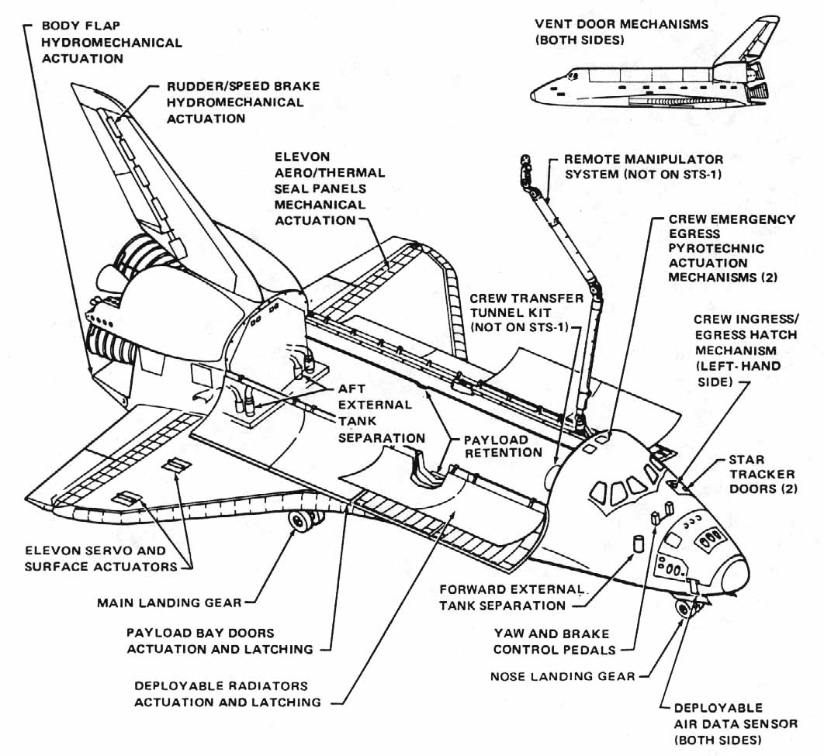
5. Steps for Making Your Special Effects Model
Step 1: Find a good reference picture of what you want to model.

Slide 48
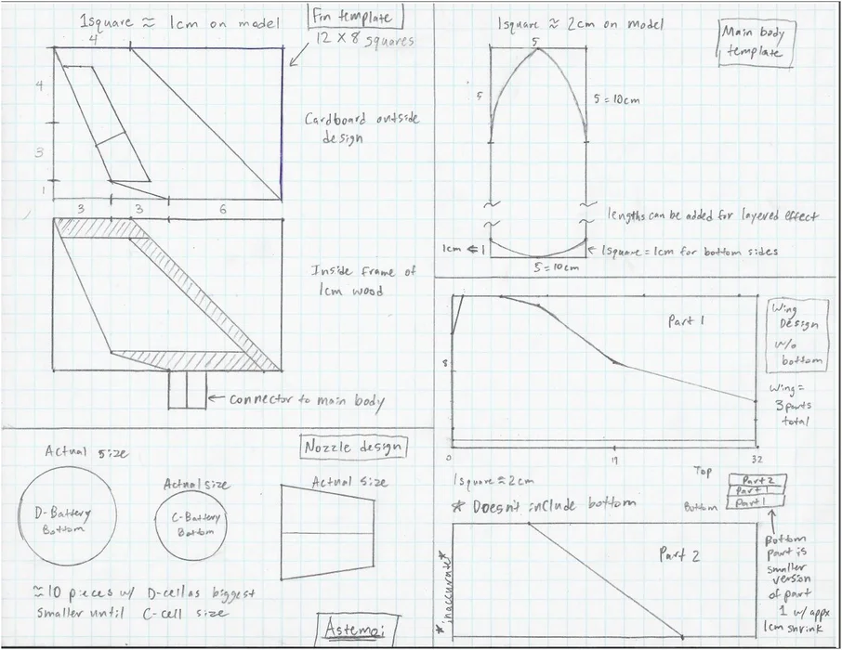
5. Steps for Making Your Special Effects Model
Step 2: Determine an appropriate scale for your design and draw it.
Determining Scale Model
Space Shuttle length = 57 meters
Desired Model Length = .50 meters
57 m = 114
.50 m
1:114 scale model

Slide 49
5. Steps for Making Your Special Effects Model
Step 3: Figure out all the parts and how they will go together.

Slide 50
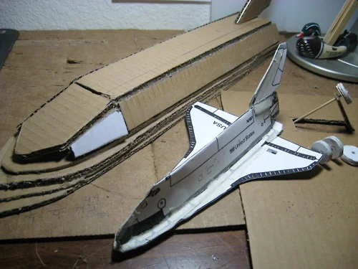
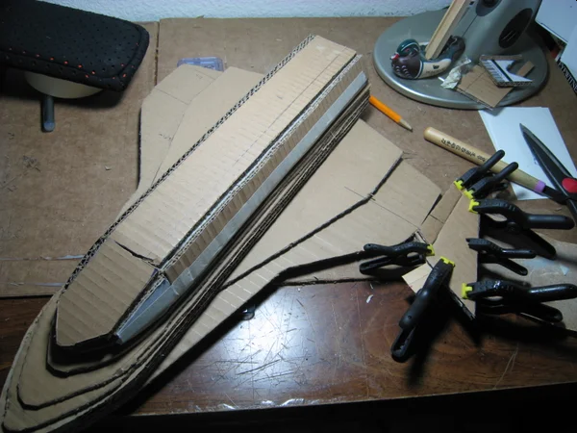
5. Steps for Making Your Special Effects Model
Step 4: Make outlines of each part and cut them out.

Slide 51
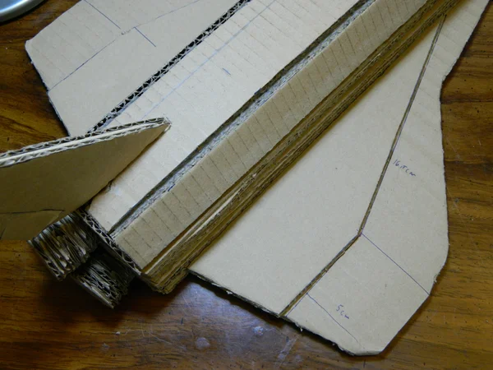
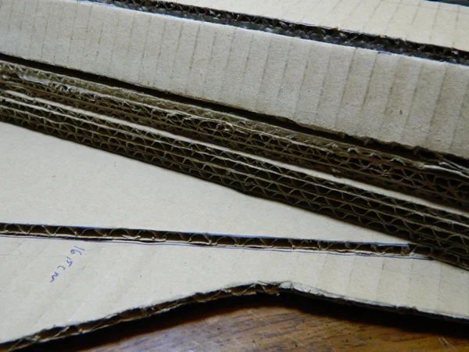
5. Steps for Making Your Special Effects Model
Step 5: Assemble the parts

Slide 52
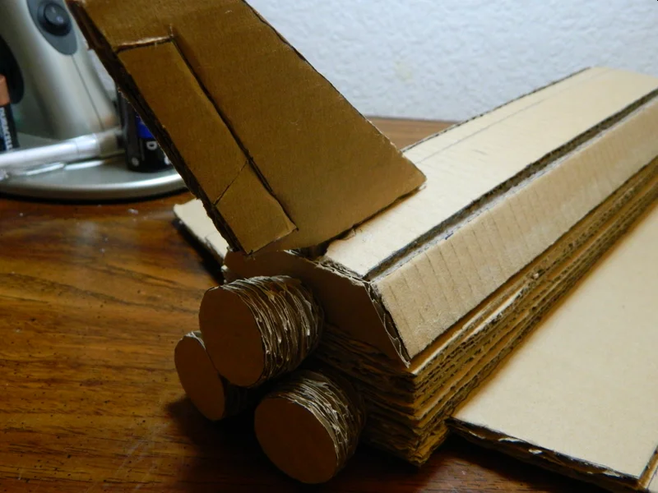
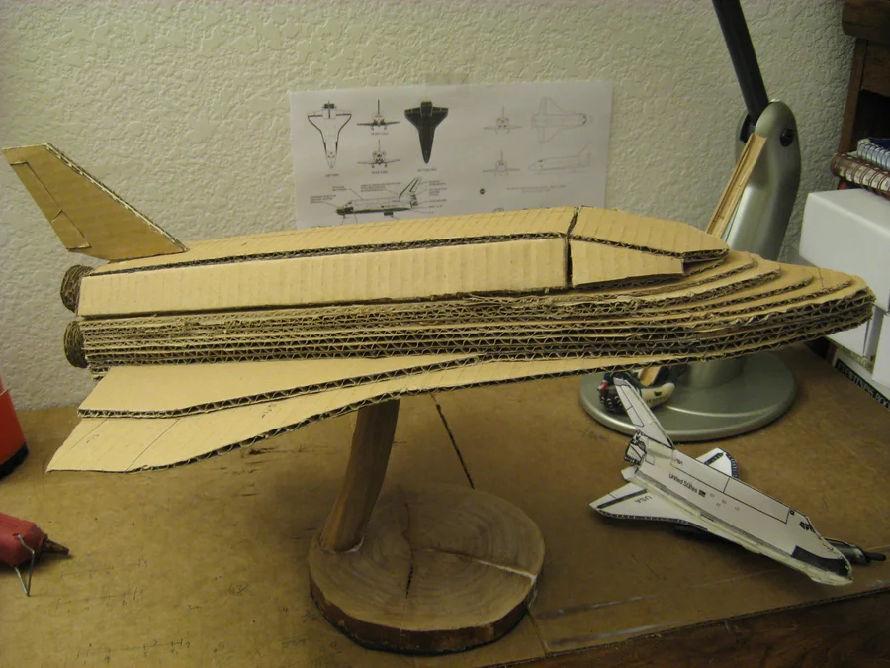
5. Steps for Making Your Special Effects Model
Step 5: Assemble the parts.

Slide 53
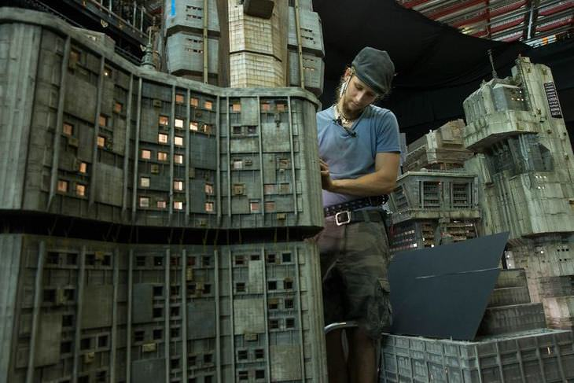
Requirement 6
List at least six occupations in which model making is used and discuss with your counselor some career opportunities in this field.

Slide 54
6. Occupations Using Model Making
Business Areas and How Models Are Used
Automobile Industry: Sales, wind-resistance testing, safety design
Toy Industry: Development and sales
Chemical and Petroleum Industries: Process piping design, offshore drilling rigs, ship design, dry materials handling.
Film and Theater Industry: Stage sets, robots, spaceships, cities, planets
Building and Construction Industries: Building and house design, office layouts, site studies, urban planning
Environmental and Civil Engineering: Topography studies, pollution studies, river flows, dams
Law: Crime scene re-creations
Amusement Parks: Rides and park layouts
Medicine and Science: Human and animal anatomy, molecular structures

Slide 55
6. Careers in Model Making
How to become a Model Maker
Those who are considering a career in the model making industry must be artistic, be able to communicate effectively with others, and be able take an idea from a simple sketch to a full-blown three-dimensional piece. They must also have an eye for detail, the ability to understand scale, have patience, and be able to focus for long periods of time. They must also have knowledge and skill with sculpting, drawing and computers, and know how to use a variety of tools, machinery and materials including glue guns, resin and plastics.
Although there are no strict educational requirements needed for this career, having practical work experience or training can help individuals find employment in the model making industry. Employers prefer that model makers have design and model making skills and experience over a degree. Finding an internship or apprenticeship is one of the best ways of gaining experience in the field. Employers will also look for a portfolio of work that demonstrates you have an eye for detail and can produce quality models to very exact standards.
Although not required, getting a degree or taking classes in fine arts, design, sculpting, drawing, painting, ceramics, metal work, woodwork, model making, computer aided design and studio arts can be very helpful.

